Slide 1








Unit 5.2
Software Engineering
Software
Testing

Slide 2
Software Testing
•
What is Testing?
Many people understand many definitions of testing :
1
Testing is the process of demonstrating that errors
are not present
2
The purpose of testing is to show that a program performs its intended
functions correctly
3
Testing is the process of establishing confidence that a program does
what it is supposed to do
These definitions are incorrect

Slide 3
Software Testing
A more appropriate definition is:
“Testing is
the
process
of
executing
a
program
with
the
intent
of
finding
errors
”

Slide 4
Error/ Mistake/ Bug, Fault/Defect and Failure
Errors:
The Error is a human mistake. An Error appears not only due to the logical mistake in the code made by the developer. Anyone in the team can make mistakes during the different phases of software development. For instance,
BA (business analyst) may misinterpret or misunderstand requirements.
The customer may provide insufficient or incorrect information.
The architect may cause a flaw in software design.
When developers make mistakes while coding, we call these mistakes
“bugs”

Slide 5
Software Testing
Defect/ Fault:
A Defect is a variance between expected and actual results. An Error that the tester finds is known as Defect. A Defect in a software product reflects its inability or inefficiency to comply with the specified requirements and criteria and, subsequently, prevent the software application from performing the desired and expected work. The defect is also known as Fault.
Failure:
Failure is a consequence of a Defect. It is the observable incorrect behaviour of the system. Failure occurs when the software fails to perform in the real environment.
In other words, after the creation & execution of software code, if the system does not perform as expected, due to the occurrence of any defect; then it is termed as Failure.

Slide 6
Software Testing
•
Why should We Test ?
Although software testing is itself an expensive activity,
yet launching of
software without testing may lead to cost potentially much higher than that
of testing, specially in systems where human safety is involved
In the software life cycle the earlier the
the lower is the cost of their removal
errors
are
discovered
and
removed,

Slide 7
Software Testing
•
Who should Do the Testing ?
o
o
Testing requires the developers to find errors from
their software
It is difficult for software developer to point out errors from own
creations
Many organisations have made a distinction between development and testing phase by making different people responsible for each phase
o

Slide 8
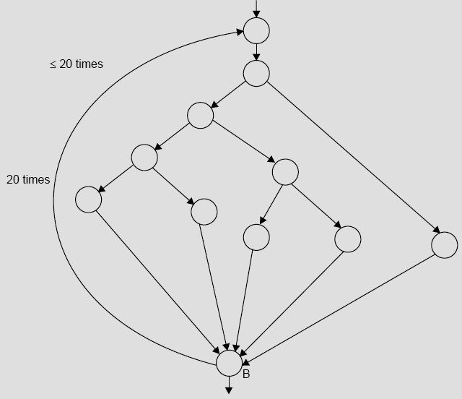
Software
Testing
Fig 1: Control flow graph

Slide 9
Software
Testing
The number of paths in the example of
Fig
1 are
10¹⁴
or 100 trillions
It is
computed from
5²⁰ 5¹⁹ 5¹⁸
5¹; where 5 is the number of paths
+
+
+ …… +
through the loop body If only 5 minutes
are required to test one
test
path,
it
may
take
approximately
one
billion
years
to
execute
every
path

Slide 10
Software Testing
_
Test, Test Case and Test Suite
Test and Test case terms are used interchangeably
In practice, both are
same
and
are
and
treated
as
synonyms
Test
case
describes
an
input
description
an
expected
output
description
Test Case ID
Section-I
(Before Execution)
Section-II
(After Execution)
Purpose :
Execution History:
Pre condition: (If any)
Result:
Inputs:
If fails, any possible reason (Optional);
Expected Outputs:
Any other observation:
Post conditions:
Any suggestion:
Written by:
Run by:
Date:
Date:
Fig 2: Test case template
The set of
test
cases is called a test suite
Hence
any combination
of test
cases may generate a test suite

Slide 11
Software Testing
_
Alpha, Beta and Acceptance Testing
The term Acceptance Testing is used when the software is developed for
a specific customer A series of tests are conducted to enable the customer
to validate all requirements
These tests are conducted by the
end user /
systematic
customer and may range from adhoc tests to well planned
series of tests
The terms alpha and beta testing are used when the software is as a product for anonymous customers
developed
Alpha Tests are conducted at the developer‟s site by some potential
customers
These tests are
conducted in a controlled environment
formal testing process is near completion
Alpha
testing may be started when
Beta Tests are conducted
by the customers / end users at
their sites
Unlike
alpha
testing,
developer
is
not
present
here Beta
testing
is
conducted in a real environment that cannot be controlled by the
developer

Slide 12
Software Testing
Boundary Value Analysis
Consider a program with two input variables x and
y
These
input
variables
have
specified
boundaries
as:
a ≤ x ≤ b
c ≤ y ≤ d
Input
domain
d
y
c
a
b
x
Fig 3: Input domain
for program having two input variables

Slide 13
Software Testing
The boundary value analysis test cases for our program with two inputs
variables (x and y) that may have any value from 100 to 300 are: (200,100), (200,101), (200,200), (200,299), (200,300), (100,200), (101,200), (299,200) and (300,200) This input domain is shown in Fig 4 Each dot represent a test case
and inner rectangle is the domain of legitimate inputs
Thus,
for
a
program
of
n
variables,
boundary value analysis
yield 4n + 1 test cases
Input domain
400
300
200
100
y
0
100
200
300
400
x
Fig
4: Input domain of two variables x and y
boundaries [100,300] each
with

Slide 14
Software Testing
Example
Consider a program for determining the Previous date.
day, month and year with the values in the range
1 ≤ month ≤ 12
1 ≤ day ≤ 31
1900 ≤ year ≤ 2025
Its input is
a triple of
The possible outputs would
boundary value test cases
be
Previous
date
or
invalid
input
date
Design
the

Slide 15
Software Testing
Solution
The Previous date program takes a date as input and checks it for validity
If valid, it returns the previous date as its output
With single fault assumption
theory,
4n+1
test
cases
can
be
designed
and
which
are
equal
to
13

Slide 16
Software
Testing
The
boundary value
test
cases
are:
Test Case
Month
Day
Year
Expected output
1
6
15
1900
14 June, 1900
2
6
15
1901
14 June, 1901
3
6
15
1962
14 June, 1962
4
6
15
2024
14 June, 2024
5
6
15
2025
14 June, 2025
6
6
1
1962
31 May, 1962
7
6
2
1962
1 June, 1962
8
6
30
1962
29 June, 1962
9
6
31
1962
Invalid date
10
1
15
1962
14 January, 1962
11
2
15
1962
14 February, 1962
12
11
15
1962
14 November, 1962
13
12
15
1962
14 December, 1962

Slide 17
Software Testing
Robustness testing
It is nothing but the extension of boundary value analysis
Here, we would
like to see, what happens when the extreme values are exceeded with a
value slightly greater than the maximum, and a value slightly less than minimum It means, we want to go outside the legitimate boundary of input
domain
This
extended
form of
boundary value analysis
5
is
called
robustness testing and shown in Fig
There are four additional test cases
which are outside the legitimate input
domain
Hence total test cases in robustness testing are 6n+1, where n is
the number of input variables So, 13 test cases are:
(200,99), (200,100), (200,101), (200,200), (200,299), (200,300)
(200,301), (99,200), (100,200), (101,200), (299,200), (300,200), (301,200)

Slide 18
Software
Testing
400
300
200
100
y
0
100
200
x
300
400
Fig
5: Robustness test cases for two variables
and y with range [100,300] each
x

Slide 19
Software Testing
Worst-case testing
If we reject “single fault” assumption theory of reliability and may like to see
what happens when more than one variable has an extreme value
In
electronic circuits analysis, this is called “worst case analysis”
It is more
thorough in the sense that boundary value test cases are a proper subset
of worst case test cases
It requires more effort
Worst case testing for a
function of n variables generate
5^{n}
test
Our
cases as opposed to 4n+1 test
cases
5²=25
for boundary value analysis
two
variables
example
will
have
test cases and are given in table 1

Slide 20
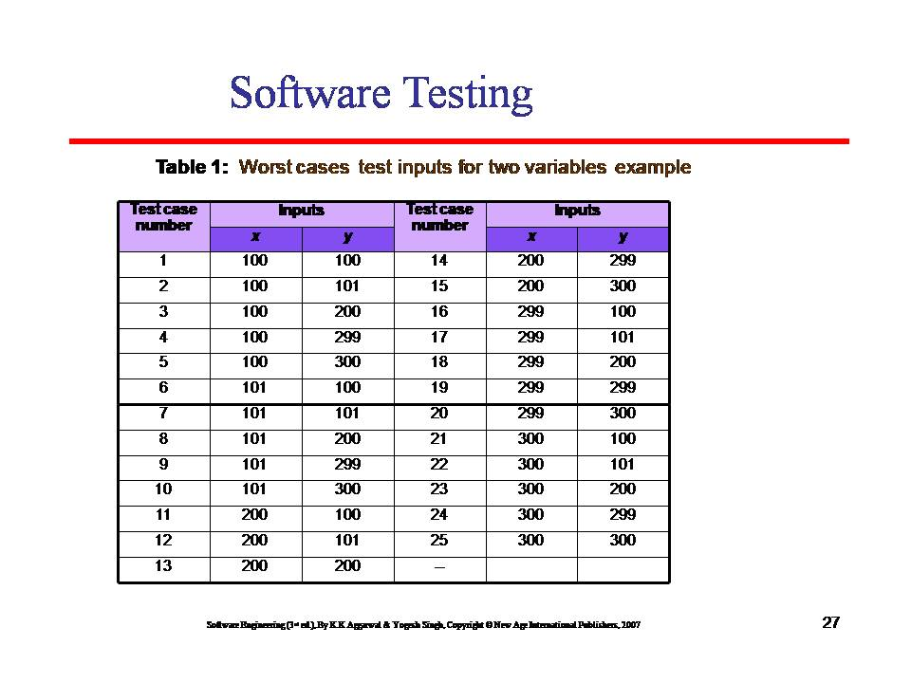

Slide 21
Software Testing
Cyclomatic complexity
Cyclomatic complexity is a source code complexity measurement that is being correlated to a number of coding errors. It is calculated by developing a Control Flow Graph of the code that measures the number of linearly-independent paths through a program module.

Slide 22
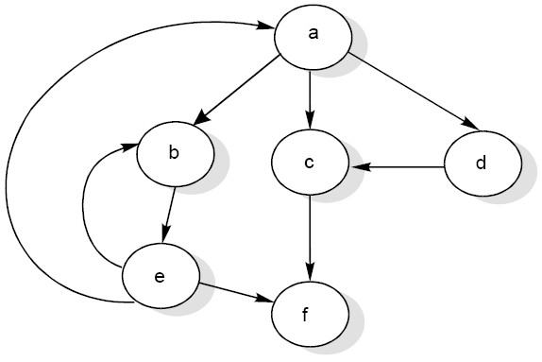
Software Testing
Cyclomatic Complexity
McCabe‟s cyclomatic metric V(G) = e – n + 2P
For
example,
a
flow graph
shown in fig
with
entry node „a‟
and
exit
node „f‟
Cyclomatic complexity = E - N + 2*P where, E = number of edges in the flow graph. N = number of nodes in the flow graph. P = number of nodes that have exit points
A cyclomatic complexity below 4 is considered good; a cyclomatic complexity between 5 and 7 is considered medium complexity, between 8 and 10 is high complexity, and above that is extreme complexity.
Fig :2
Flow graph

Slide 23
Software Testing
The value of cyclomatic complexity can be calculated as :
V(G) = 9 – 6 + 2 = 5
Here
e = 9, n = 6 and P =1
There will be
Path 1 :
Path 2 :
Path 3 :
Path 4 :
Path 5 :
five
independent paths for the flow graph
a c f
a b e f
a d c f
a b e a c f or a b e a b e f
a b e b e f
illustrated
in
Fig
2

Slide 24
function fizzBuzz($start, $max) {
$return = array();
// sanity check
if($max < $start) {
return false;
}
for($i = $start; $i < $max; $i++) {
$result = '';
if($i % 3 == 0) {
$result .= 'fizz';
}
if($i % 5 == 0) {
$result .= 'buzz';
}
if(!$result) {
$result = $i;
}
$return[] = $result;
}
return implode($return, ',');
}
Complexity = 6

Slide 25
function fizzBuzz($start, $max) {
$return = array();
// sanity check
if($max < $start) {
return false;
}
for($i = $start; $i < $max; $i++) {
$return[] = determineFizzandBuzz($i);
}
return implode($return, ',');
}

Slide 26
function determineFizzandBuzz($value) {
$result = '';
if($value % 3 == 0) {
$result .= 'fizz';
}
if($value % 5 == 0) {
$result .= 'buzz';
}
if(!$result) {
$result = $value;
}
return $result;
}

